Slide 1






PRESENTATION 2026
FacultyBalance-AI Assisted Faculty Time Allocation
Mentor Name
Faculty Email
Faculty Name
Ms.R Uma Maheswari
Chrama.24@gmail.com
Dr Rama Mokkarala

Slide 2

Outline
Abstract of the Project
Problem Statement
Proposed Solution
System Architecture
Live Demo of the Project
Embedded Video of Project
Conclusion
Future Scope

Slide 3

Abstract
Develops a unified dataset
Quantifies Imbalances & Proposes redistribution strategies
Tools & Technologies: Excel + Power BI + Copilot+ Azure
Expected outcomes :
A Unified and cleaned Dataset.
An interactive Dashboard
Key Highlights:
Comprehensive workload summaries
Fairer workload allocation
strengthen departmental research capacity.

Slide 4

Problem Statement
Core Problem: Institutions lack a unified and data-driven mechanism
Significance of the problem: Reactive Administrative decisions taken increase the risk of burnout
Faculty Members of Higher Education Institutions
Web Based Models & lack of AI assisted Models
Scope & Boundaries: Unified Real Time Data collection, visualization and AI assisted insights.

Slide 5

Proposed Solution
To develop a unified dataset
Teaching Hours
Research & Administrative responsibilities
To design an interactive Power BI dashboard
Visualizes workload distribution at individual & departmental levels
Provides Teaching KPIS, Service Hours KPIs and Balance KPIs
To integrate AI and generate workload summaries
Methodology & Tools: Excel, Power Query Editor, Power BI, Copilot, Azure, Azure Data Factory, Data pipeline

Slide 6

Key Advantages
Comprehensive Workload Visibility
Enhanced Decision Support
Data Driven Redistribution
Leverages AI tools like Copilot to accelerate analysis and reduce human error
Improved Research Time Allocation
Cost-effective
Early Imbalance Detection
Fairness and Morale

Slide 7
System Architecture
Data Input / Source
Processing / Analysis
Real Excel Dataset with 109 rows and 25 columns
Primary sources: Departmental workload documents and timetables
IQAC committee allocation sheet
Power Query to normalize text and numeric formats
Apply Business rules
Computed derived fields
Used Power BI for dashboard development
AI / Tool Integration
Output / Dashboard
Excel used for Data input and cleaning using Power query editor.
Power BI to develop visualizations Dashboard
Copilot was used to generate insightful summaries for actionable insights
Dashboard -
Departmental KPIS,
Teaching KPI, Research
Admin KPIs and Balance KPIS

Slide 8
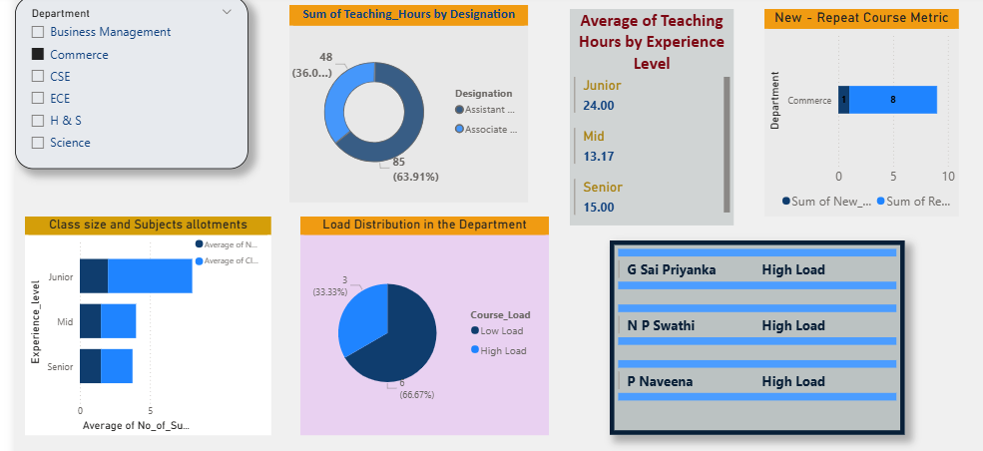
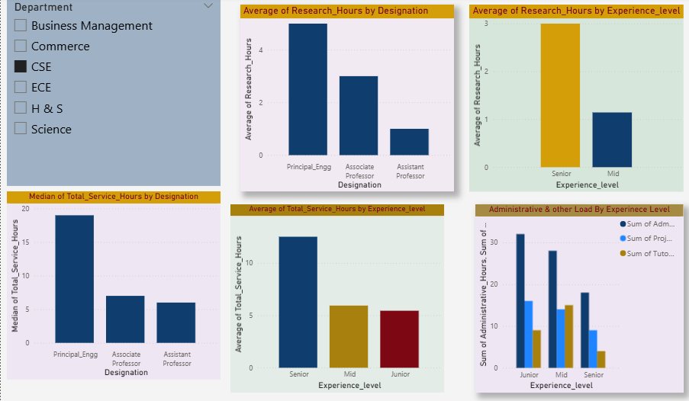
Live Demo of Project
Here's the list of some demo screenshots / features of the project:
Teaching KPIs:
Department‑wise teaching load distribution
New course allocations
Class size
Teaching Hours by Experience Level
High‑load faculty Visualized
Research hours shown categorically
Median and total service hours. Administrative loads are categorized by experience,
A clear view of balance and alignment with institutional norms

Slide 9
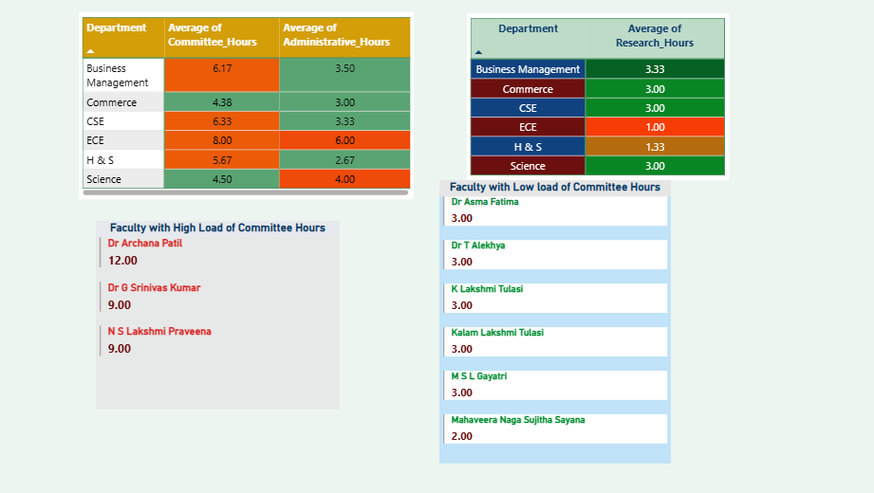
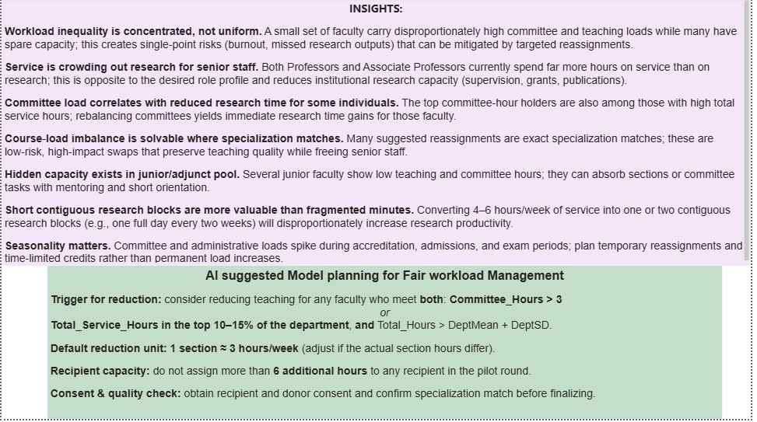
Live Demo of Project :
Here's the list of some demo screenshots / features of the project:
Department wise averages of Research, Service & Administrative hours.
Highlighting correlations
AI generated insights guiding fair reallocation and improved research time

Slide 10
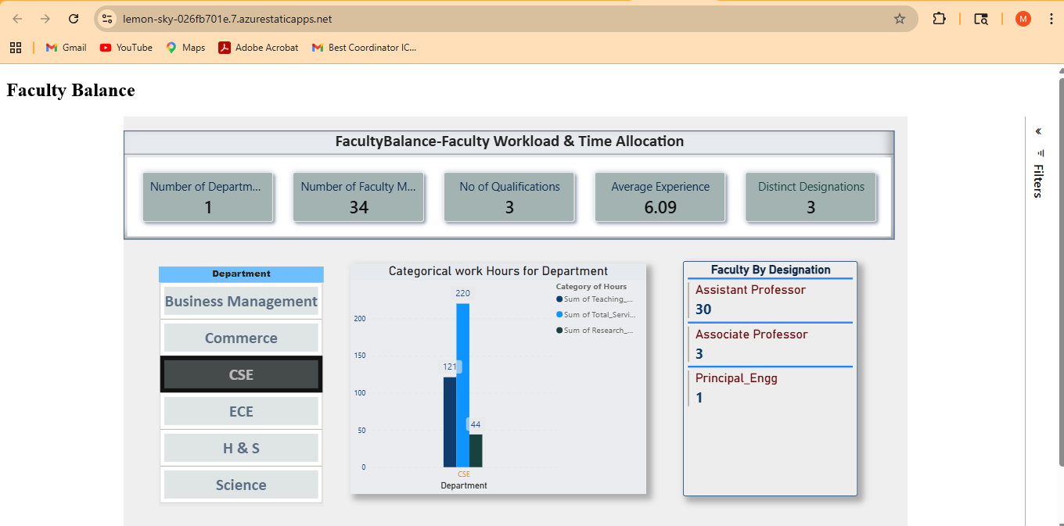
Deployed in Azure: https://lemon-sky-026fb701e.7.azurestaticapps.net/

Slide 11
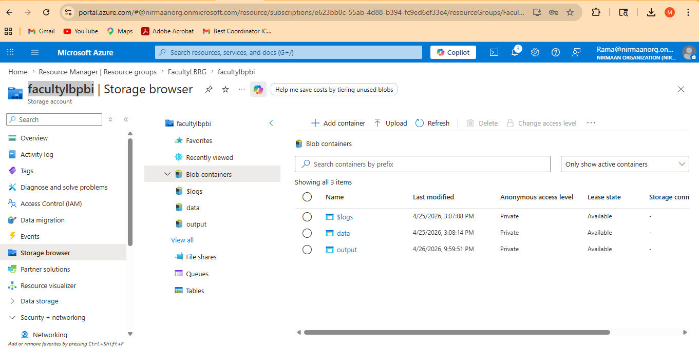
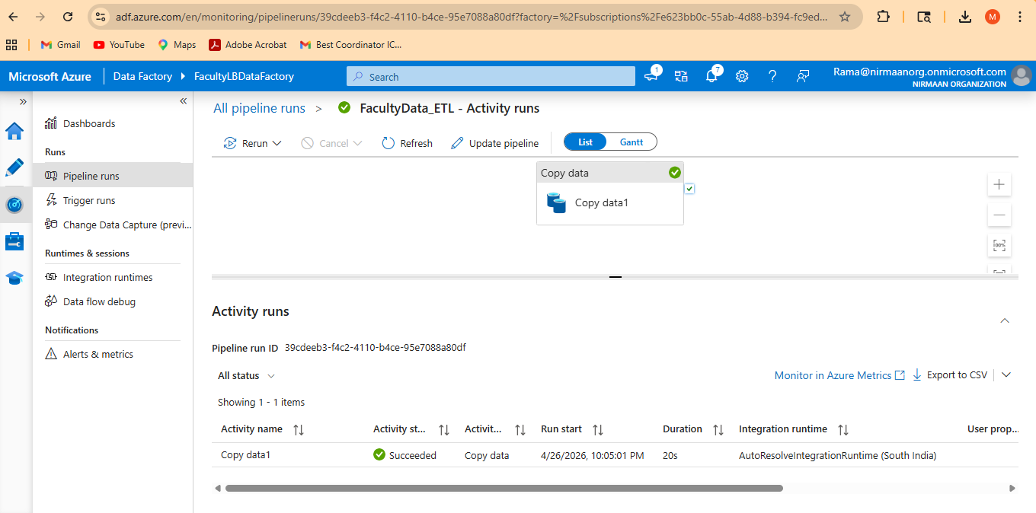
Created Blob storage
Created the Data Pipeline in Azure Data Factory

Slide 12
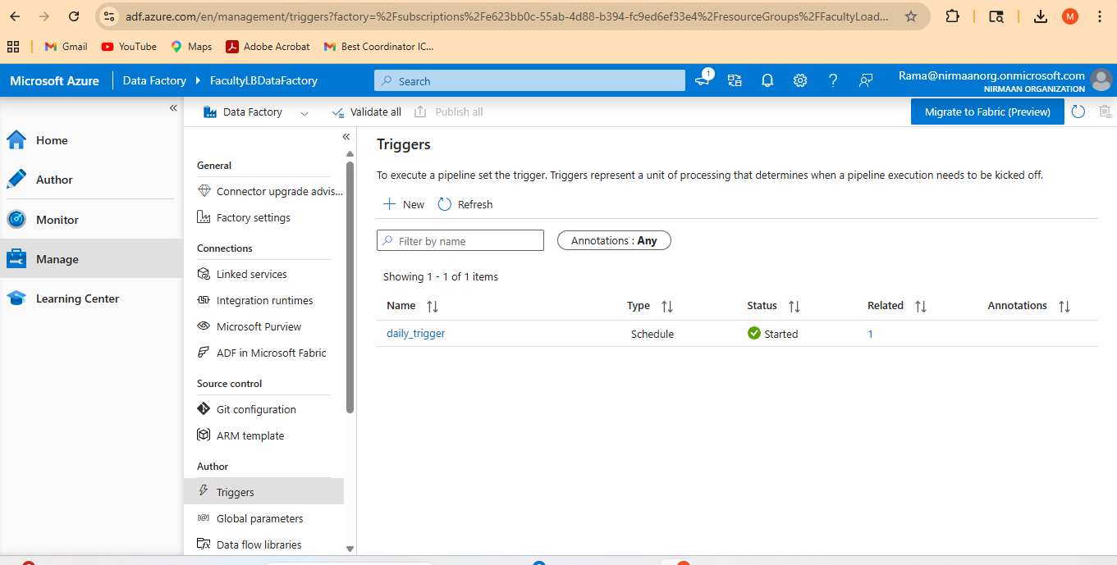
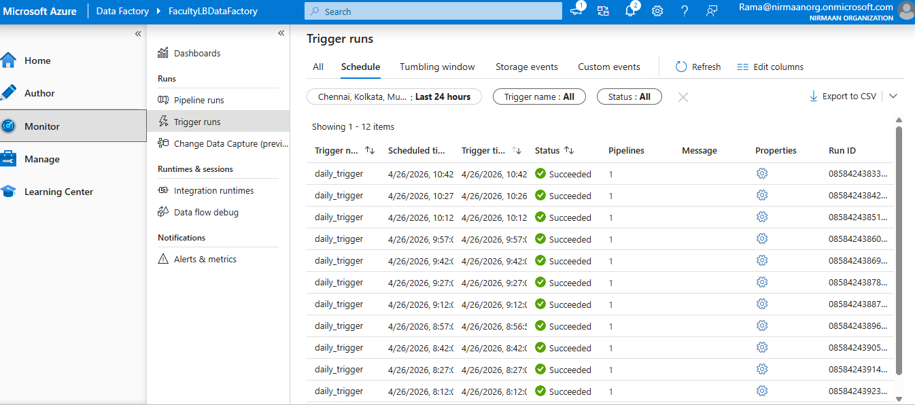
Created a Trigger
Trigger Run successful

Slide 13

Video Demo
Video of Project Demo
▶
[Insert your project demo video.
You can embed a video your live project.]

Slide 14

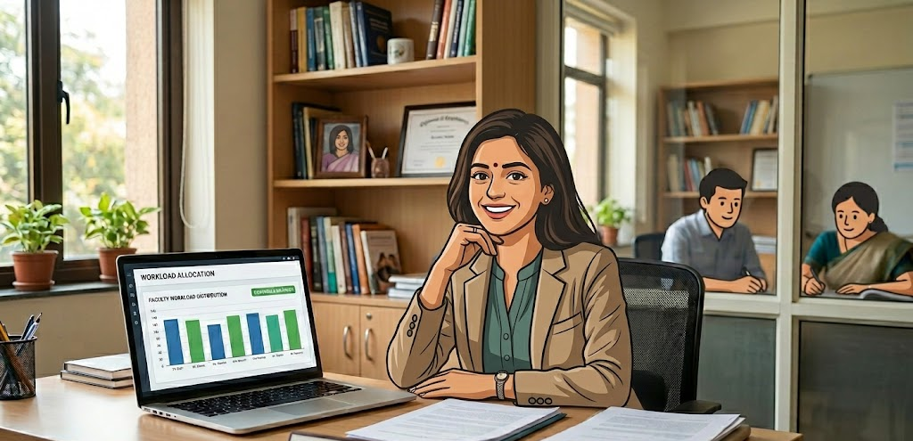
Conclusion
The project successfully developed a unified and cleaned dataset
The dashboard captured all the components through KPIs and revealed correlations
The imbalance detection and redistribution modelling offered actionable insights for fairer workload allocation.
The project further benefited from AI‑assisted insights through Copilot
Project is deployed on Azure Platform
The data had been stored on Blob Storage of Azure data Factory
A trigger is created successfully using the data pipeline to enable continuous data ingestion
CONCLUSION

Slide 15

Future Scope
Apply Machine Learning models on Faculty Load Balancing
Build a web-based interface or Power Apps solution for non-technical end users
To develop a chatbot interface to have a conversational flow

Slide 16

Q & A

Slide 17
Thank You
AICW Fellowship | Student Project Presentation 2026
LinkedIn | Edunet Foundation

